Slide 1
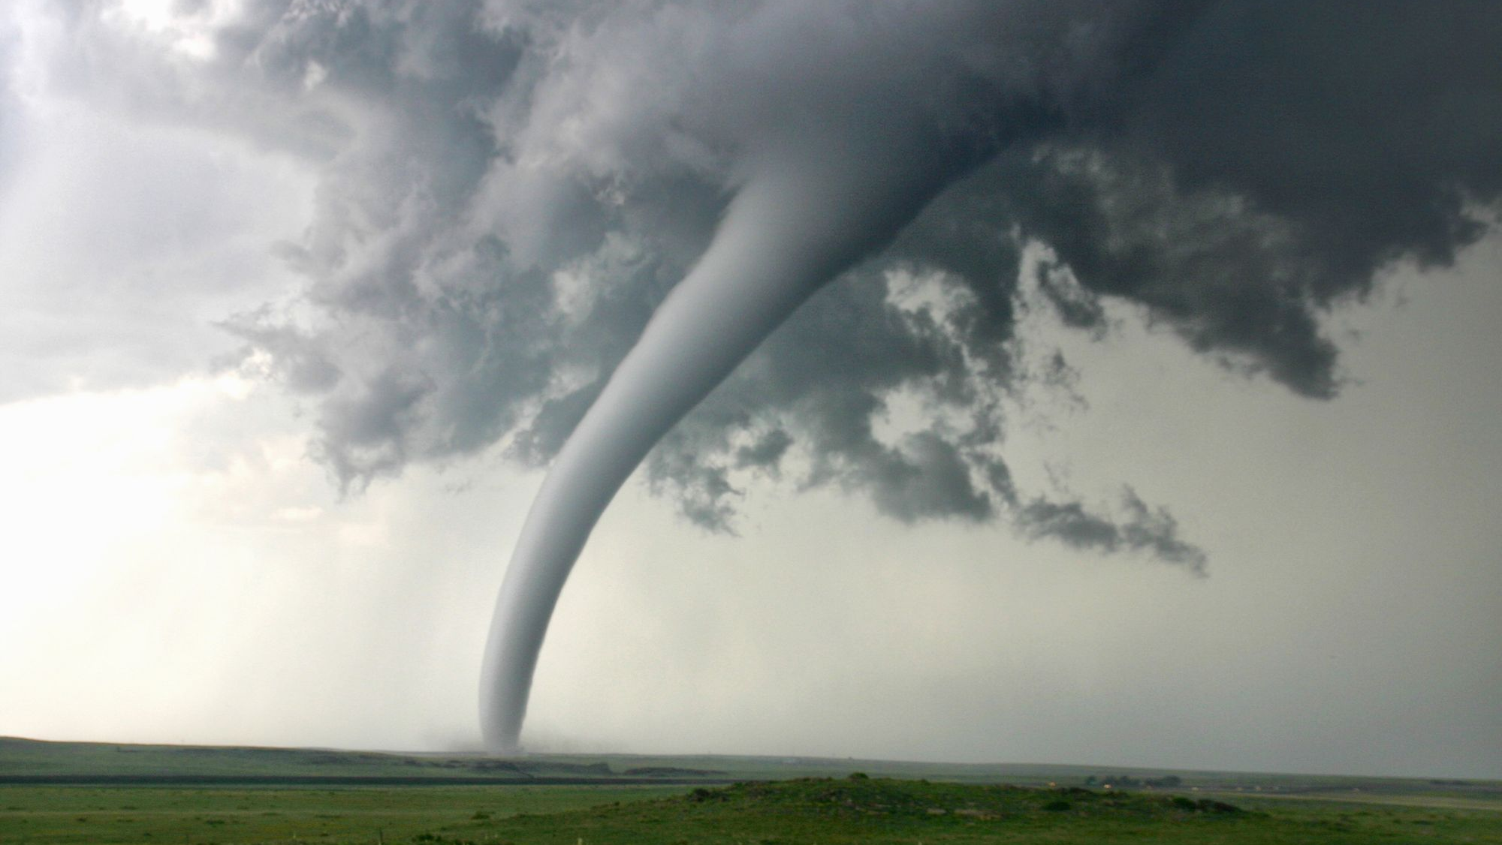

Iteration 2 Presentation
Tornados in the Last Century
Sam Dean and Matthew bauer
Client: Tom Coffin

Slide 2


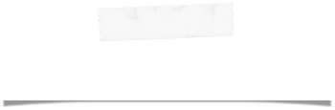
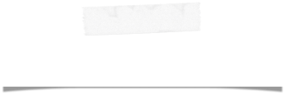
Team Members
Project Manager
Matthew Bauer
Project Documenter
Samuel Dean
Major Role: Visualization
Minor Role: Data Analyzer
Major Role: Data modeler
Minor Role: Data analyzer

Slide 3
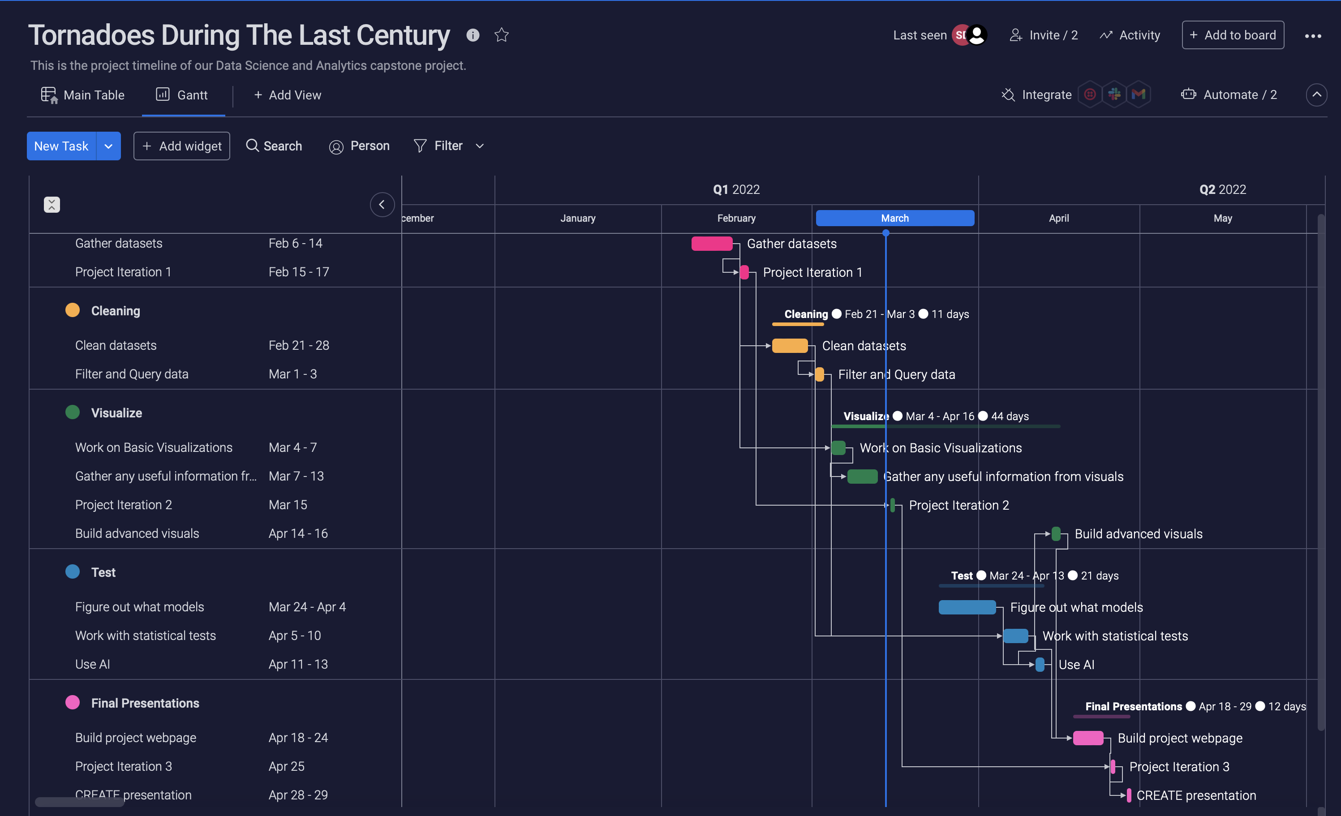
Timeline

Slide 4
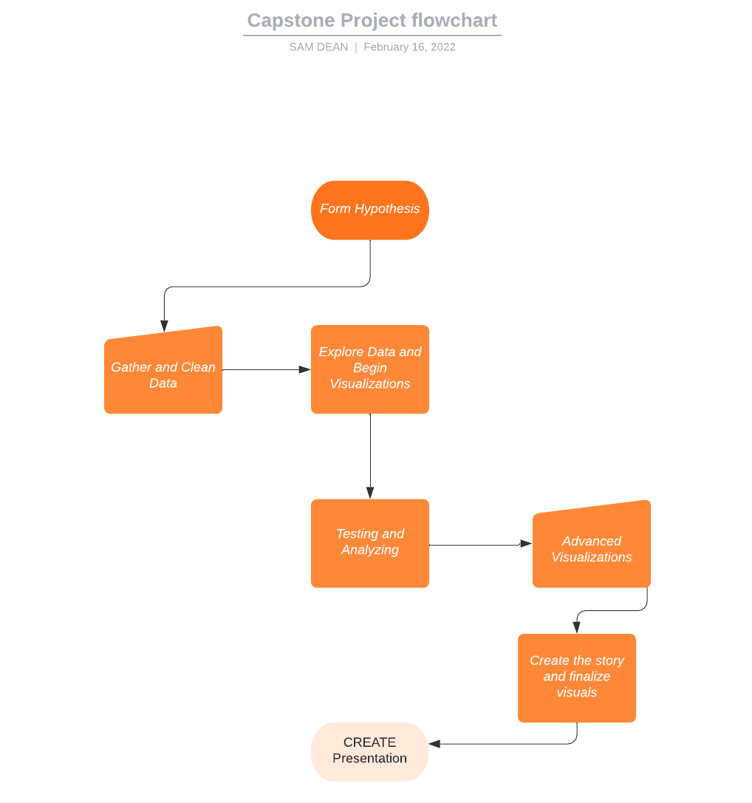
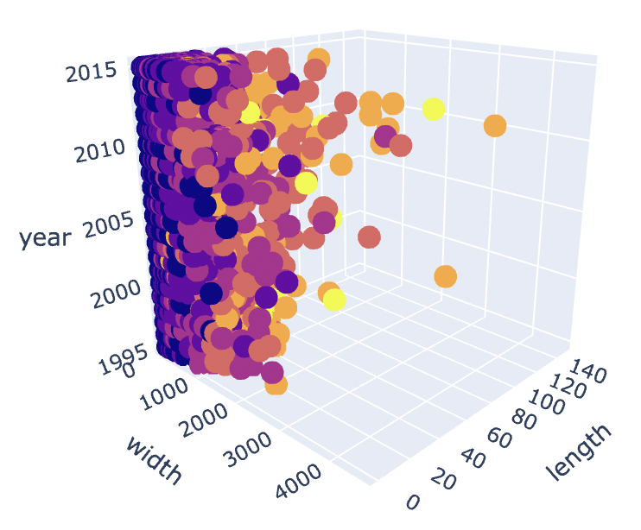
Project Flowchart
We are currently in between the creating visualizations and Testing and Analyzing phase

Slide 5
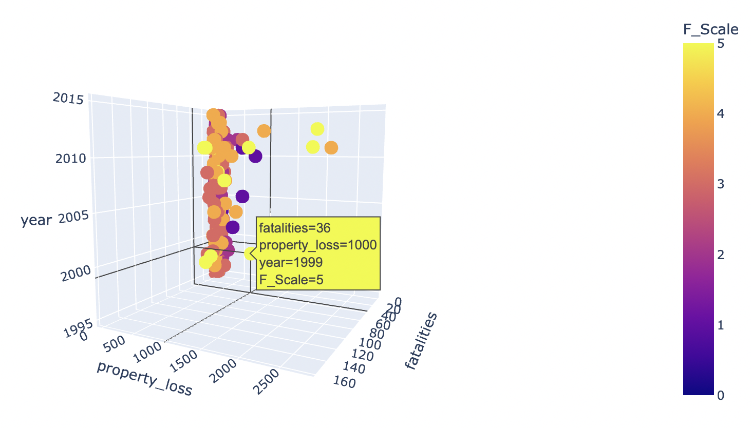
Project in Current State
Currently working on four hypotheses
Basic statistics created for each hypothesis
Basic machine learning algorithms used on applicable hypotheses
3D scatterplots have been constructed for each

Slide 6
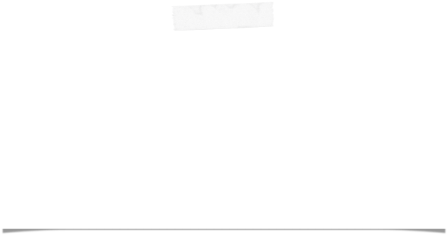
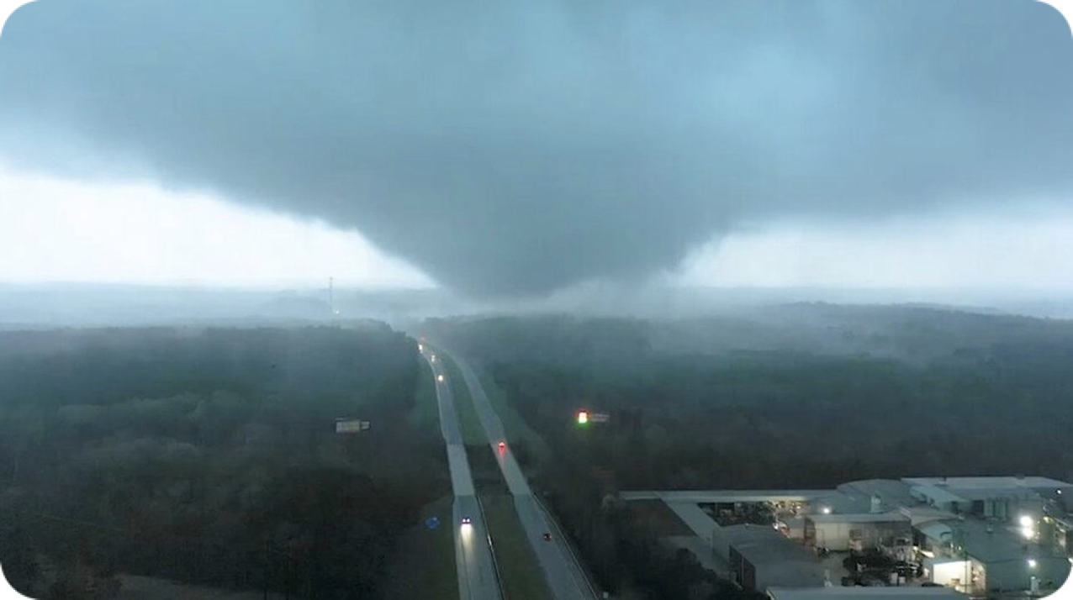

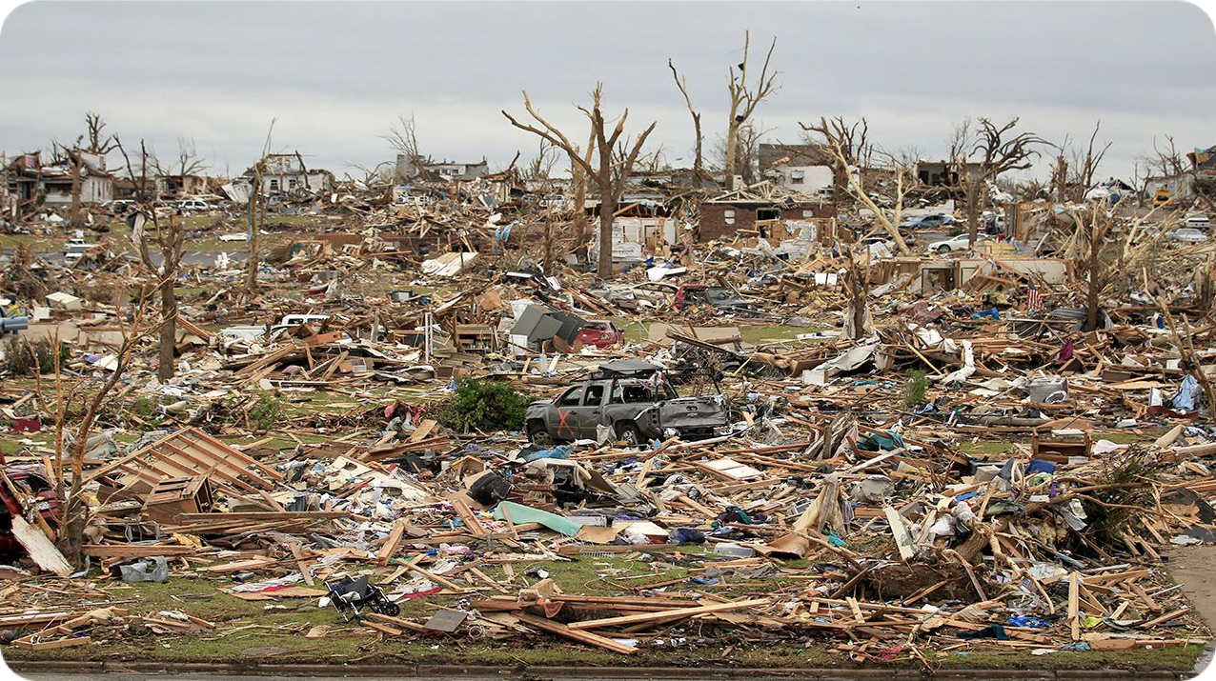
Current Hypotheses - Sam Dean
Hypothesis 3:
Longer and wider tornados have been happening more and more in the last 20 years
Hypothesis 2:
Property loss damage/Fatalities will continues to rise due to more frequent tornados

Slide 7
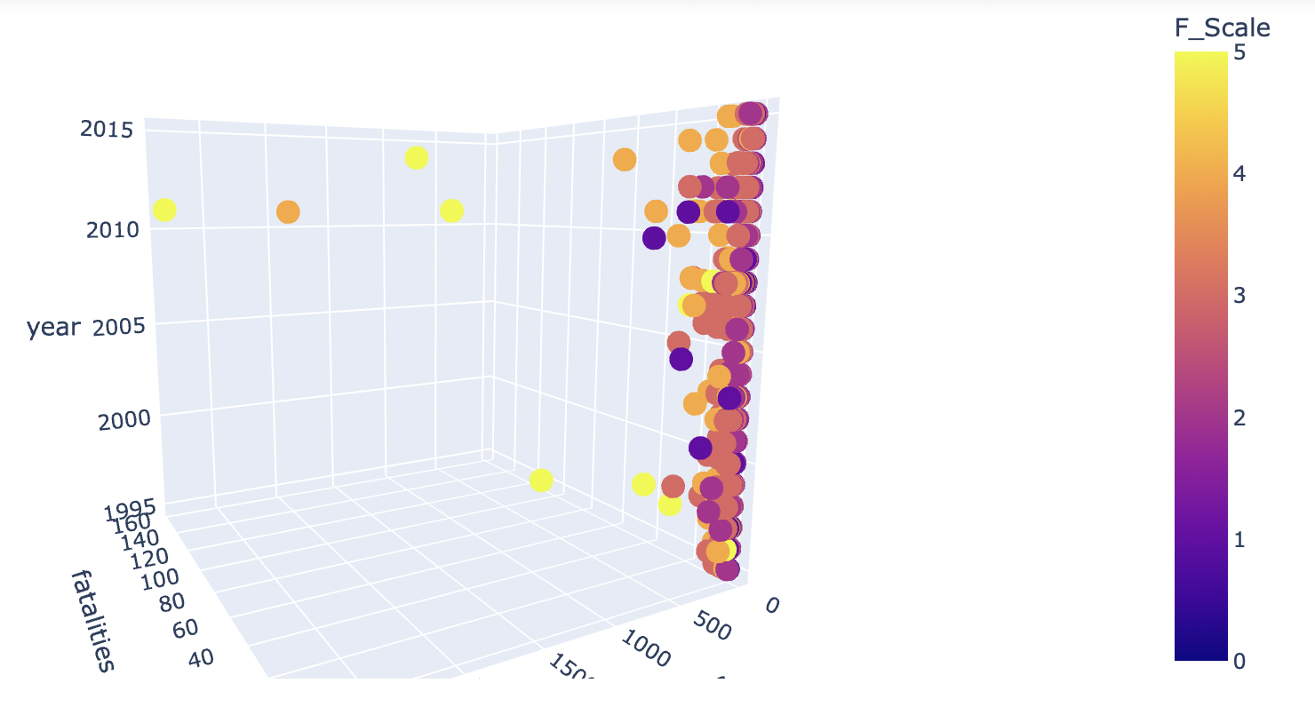

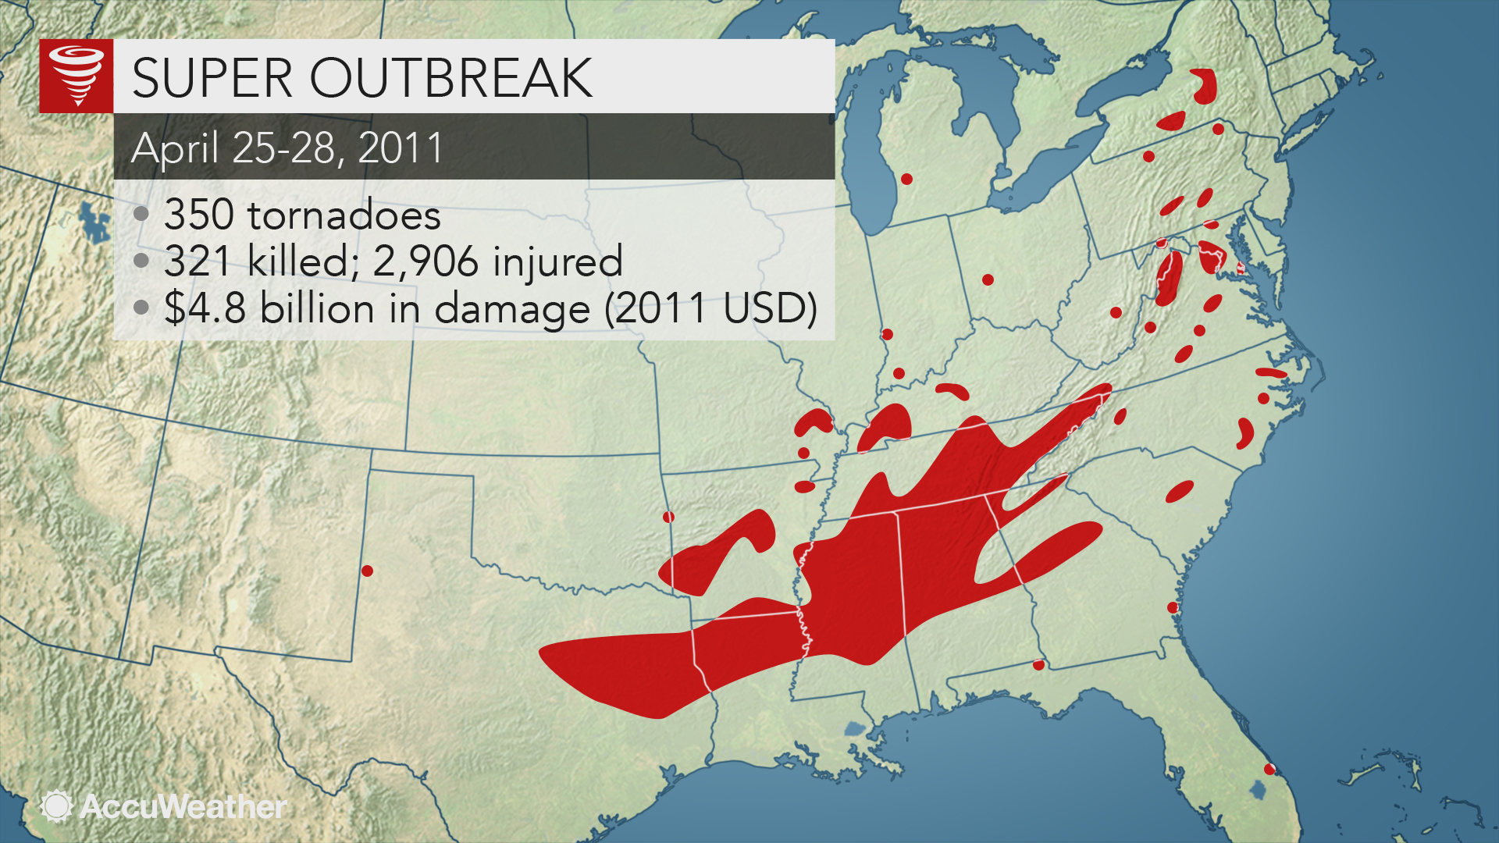
Personal Findings
In my visualizations using 3D plots, I noticed there were a spike of very large tornados in 2011 and decided to investigate
After a quick Google search, I learned that is because of the 2011 Super Outbreak, which is the largest and one of the most deadliest outbreak of tornados ever recorded
April 27th, 2011 was the worst day with 216 tornados recorded in a 24 hour period

Slide 8
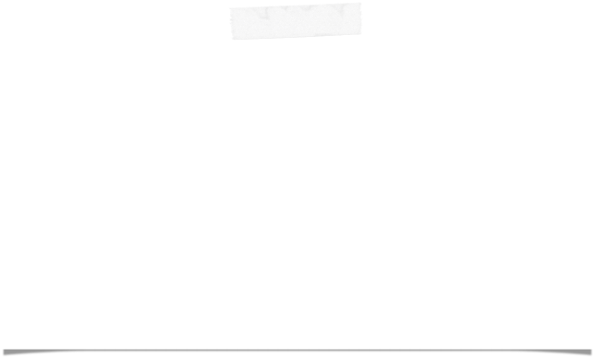
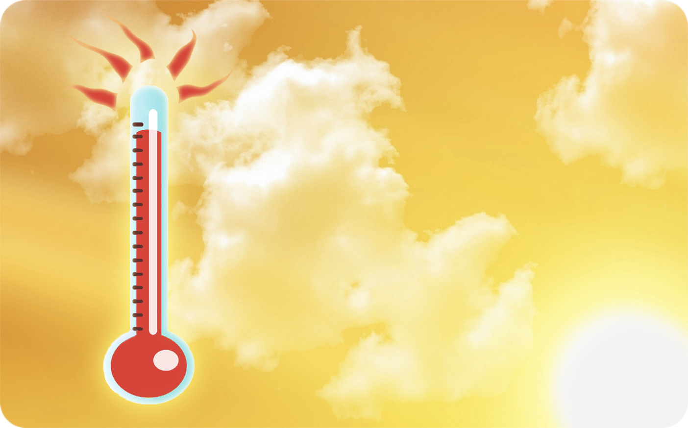

Current Hypotheses - Matthew Bauer
Hypothesis 1:
Global warming and hotter temperatures is creating more higher F-Scale tornados and causing more destruction
Hypothesis 4:
Evening time(hottest part of the day) are when the higher F-Scale tornados happen more frequently

Slide 9
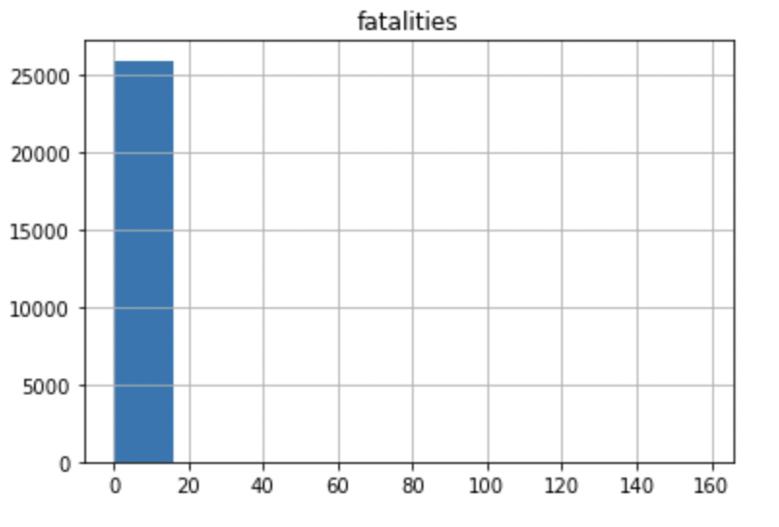
Current Issues
Too much initial data
Recording tornado data was not as good before the 1990’s
A large majority of recorded tornados are very small
Possible Solutions
Slice data to focus only on outliers or exclude them
Study only the data after 1990
The amount of data and small number of outliers make visualizations like histograms and basic scatterplots not useful

Slide 10



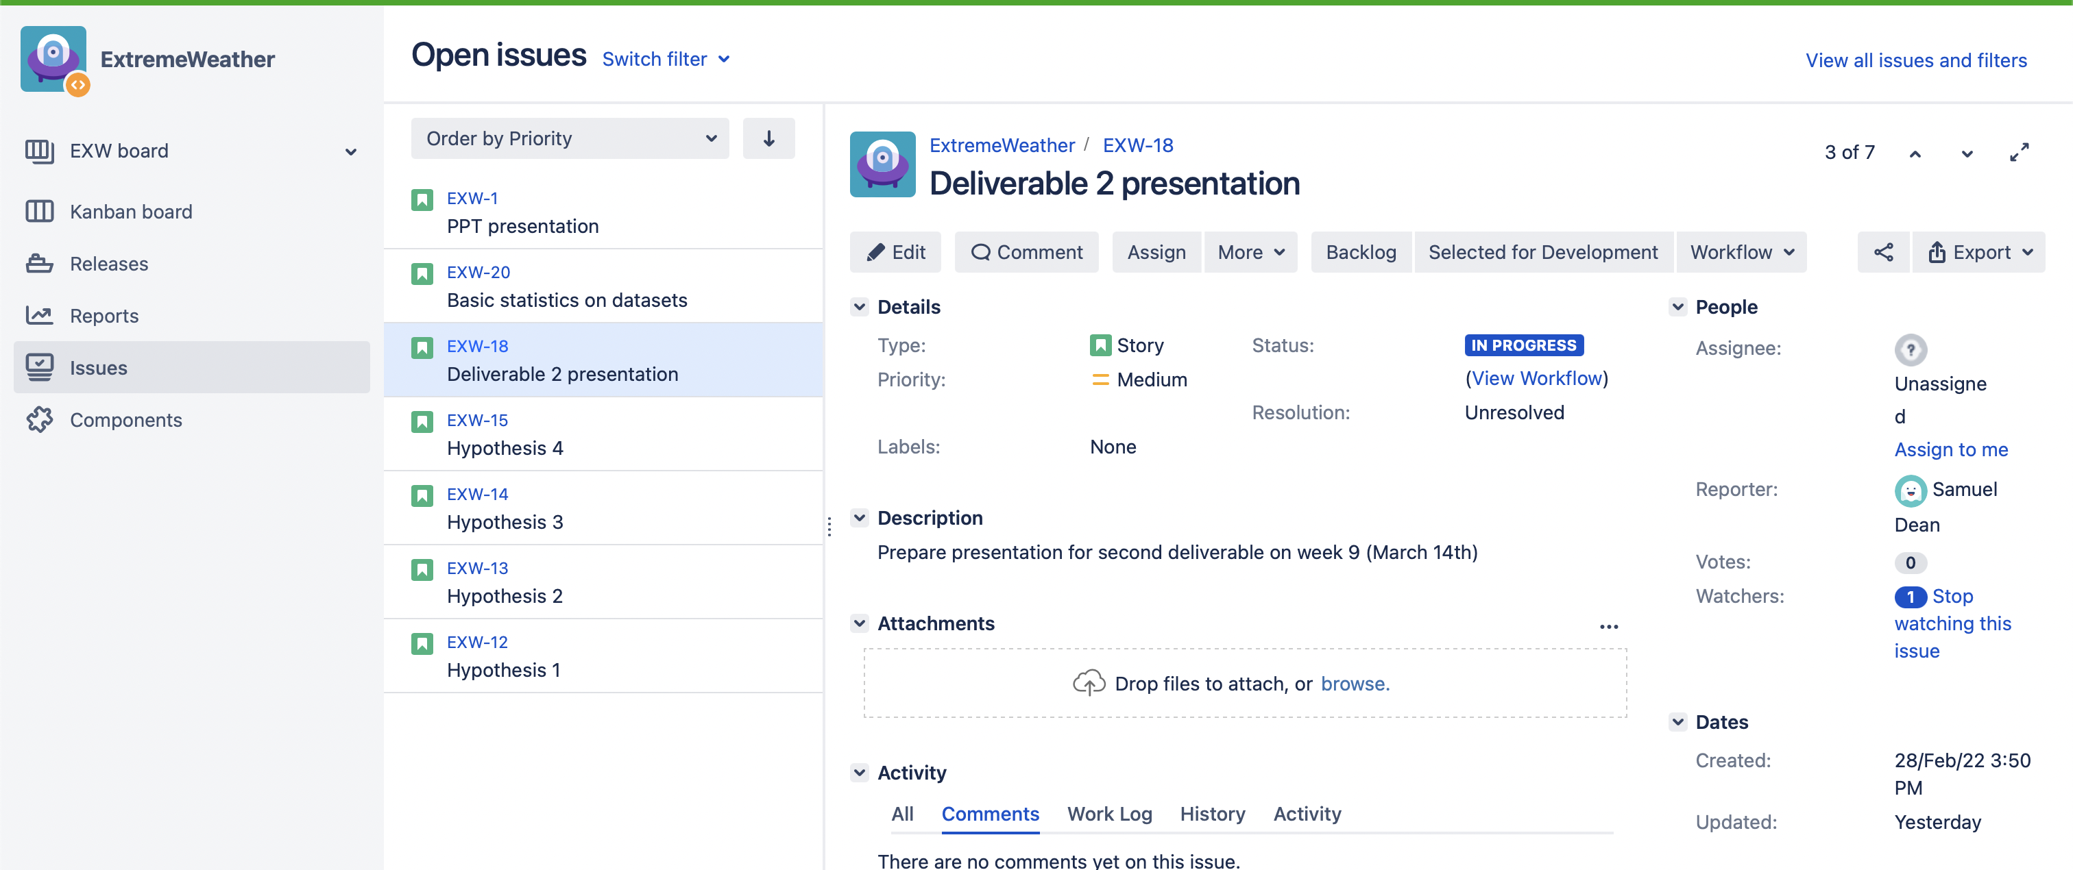

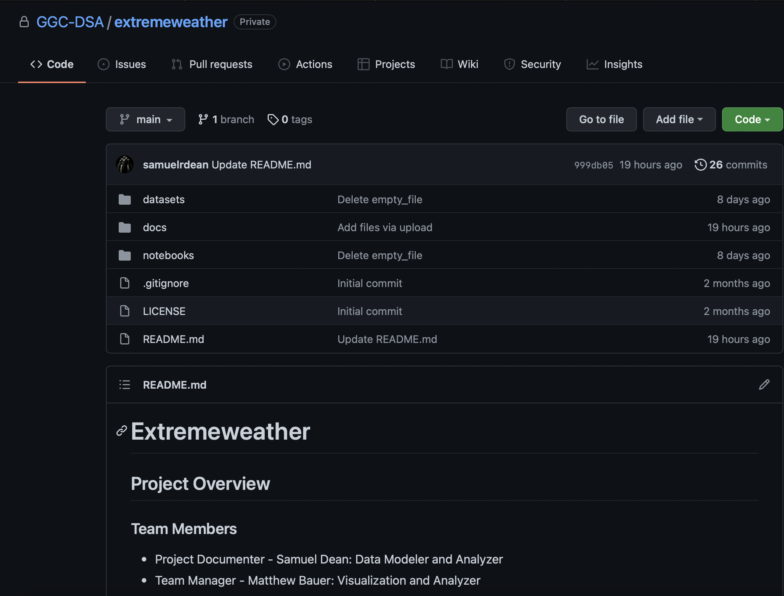

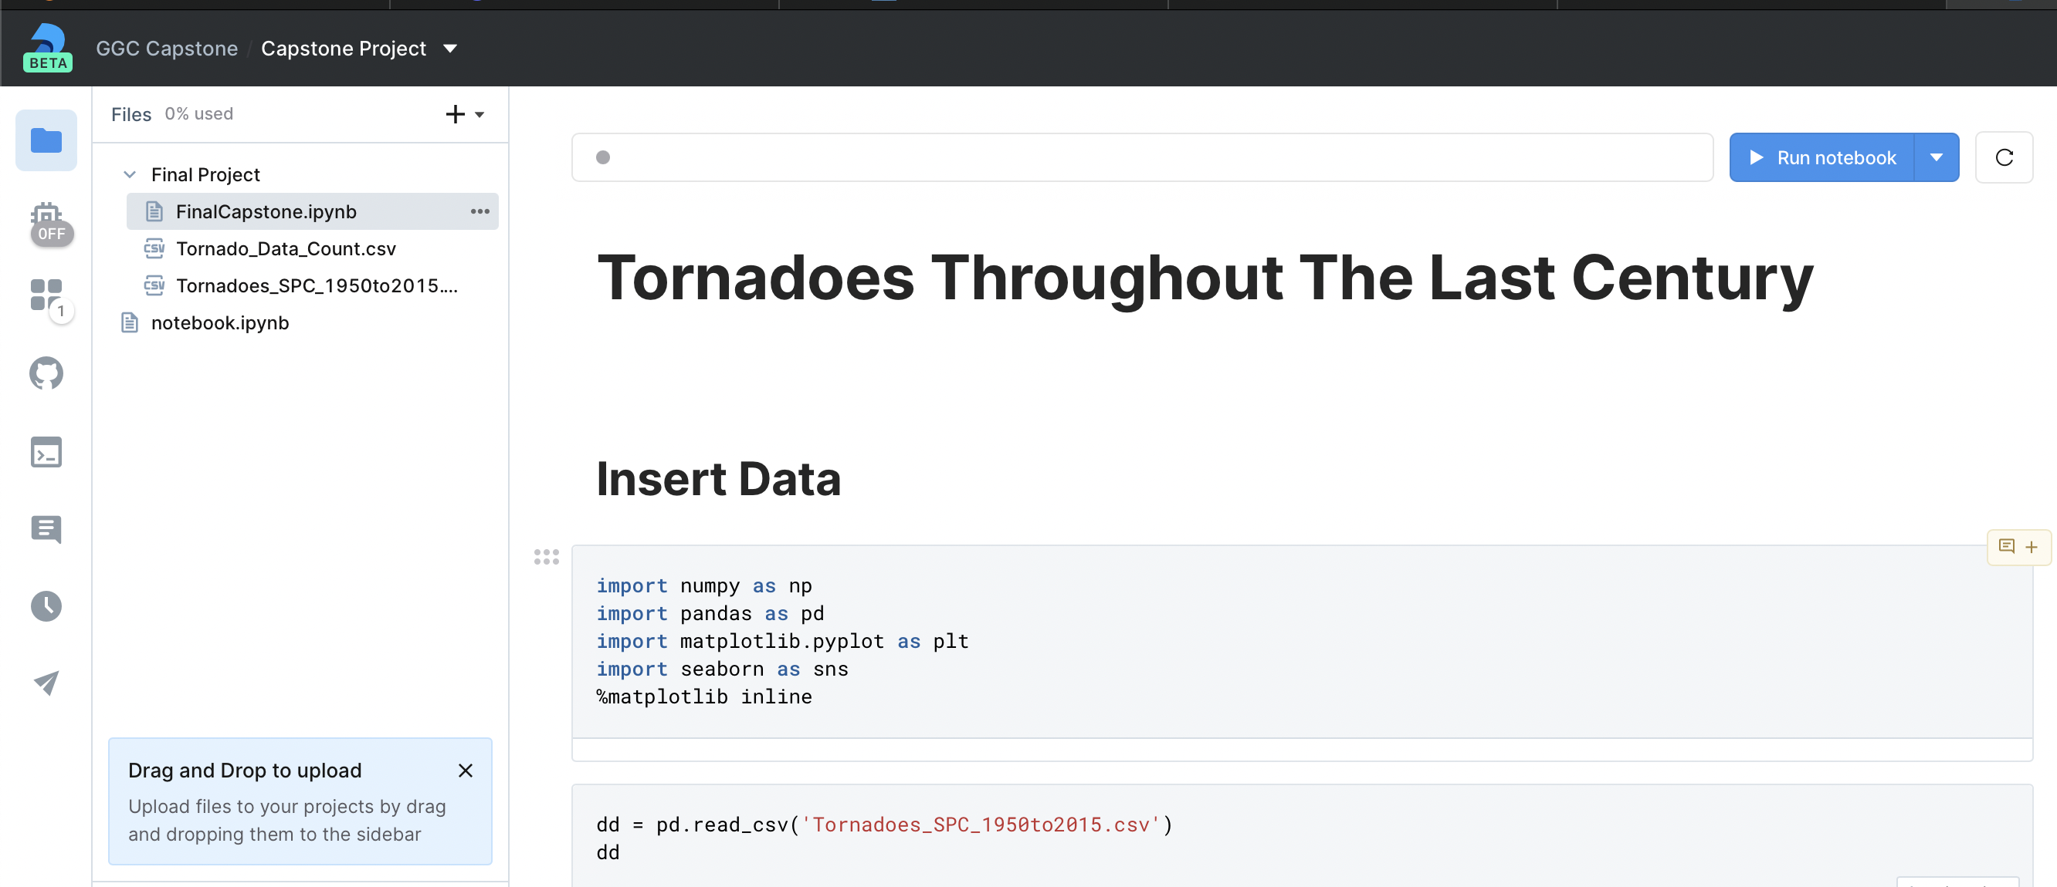

Project Management and Technologies
GitHub
Jupyter Notebook
And Deepnote
Jira

